Slide 1
An Introduction to Data Science in Python
Quick Ins & Outs for Python Use in D.S.
Instructor: Matthew Kongsiri
August 2022

Slide 2

BootCamp Outline
Introduction - Data Science & Python
Module I - Environment Set-Up
Module II - Python Basics
Module III - Repos: Saving & Sharing Work
Module IV - Data Science Basics
Module V - Practical Data Science Session
Module VI - Enhancing, Selling, & Delivering
Notes:
Original Goal: Provide insights into the complexity involved in Data Science, particularly the types of decisions that must be made and the consequences of those choices.

Slide 3
Goal
Explore foundational aspects of Data Science.
Focus
Utilizing Python to conduct Analytics & Machine-Learning in well-developed environments.
Notes:
Original Goal: Provide insights into the complexity involved in Data Science, particularly the types of decisions that must be made and the consequences of those choices.

Slide 4
True Goal is Exposure.
You are not going to remember every aspect of Python that this course covers.
But, ideally, you will remember the topics.
My intention is to provide materials that you can reference back to as needed while also teaching you how to (literally) google coding assistance.
Notes:
This work is a compilation of important topics to current work in industry, general comp sci standards, and various tutorials from across the internet.

Slide 5
Data Engineering - the application of technology to help collect, store, process, transform and structure data to enable it to be used for decision support.
Data Science - the application of math and technology to solve focus business problems. This involves analysis, visualization and algorithmic/mathematical computations to extract insights
Decision Science - the interdisciplinary application of business, math, technology, design thinking and behavioral sciences to enable better decisions... It enables the on-going creation, translation and consumption of data-driven insights to help organizations make better decisions.
http://analytics-magazine.org/executive-edge-why-some-data-scientists-should-really-be-called-decision-scientists/
Notes:
Basic Definitions -- What is the role you are looking to fill?
Tip for Job Apps - Always ask questions about the workflow and process -- a company that doesn’t have well-organized data storage is unlikely to truly use a Data Scientist; you’ll wind up doing a lot of Data Engineering (potentially years of it) prior to real modeling

Slide 6

Machine Learning Gone Wrong
A video feed of a subway platform was used to train a model to open a door if the platform was busy. It seemed to work very well until it was found the door opened during a holiday when no one was around.
It turned out there was a clock in the video feed and the model learned to open at particular times, not in response to crowding. It became an overly complex timer rather than a crowd detector.

Slide 7


Machine Learning Gone Wrong
A model was trained to differentiate US vs Russian Tanks.
It scored very highly on their data set, but failed in practice.
Their pictures of US tanks were taken in daylight, as we had easy access to pictures of them. The Russian tanks were from surveillance photos, which were taken at night.
The algorithm was a day vs night detector.

Slide 8
Decisions made prior to model implementation have massive impacts on the output of a model.
It is incredibly easy to miss something simple and create an ill-functioning model despite the accuracy score.
Notes:
The jobs you take on as a Data Scientist and the work you will do in those positions can have very large, impactful effects. Always double check that the processes and models developed don’t have unintended consequences.

Slide 9
Python is the Programming Language of Choice in Data Science
R can be useful for running complex statistics.
Scala is the base language of Apache Spark.
PySpark is another pythonic language that can utilize Spark.
Notes:
Apache Spark - a method of distributed computing that can be accomplished locally as well as in the cloud

Slide 10
Fields of Machine-Learning
Natural Language Processing (NLP)
Named Entity Recognition (NER)
Question & Answering (QA)
Sentence Classification (Sentiment / Topic Analysis)
Computer Vision / Image Processing
Object Detection
(Knowledge) Graph
Link Prediction
Shortest Distance
Reinforcement Learning
Task Scheduling
Classification Algorithms
Recommender Systems
Item Rank
Notes:
NLP Libraries: SpaCy, StanfordCoreNLP, AdaptNLP
NLP Models: FLAIR, BERT
Models Utilize: Vectors / Word Embeddings

Slide 11
Module I - Environment Set-Up
Command Line
Anaconda
Virtual Environments (VENV)
Python IDEs/Editors
Jupyter
Visual Studio Code
Notes:
Original Goal: Provide insights into the complexity involved in Data Science, particularly the types of decisions that must be made and the consequences of those choices.

Slide 12
Environment Set-Up
Command Line (CLI) Prompt Basics
Terminal and/or the Command Prompt are not always the simplest or most intuitive to use, but are important tools. They are powerful apps that provide access to the core of the OS you are working on.
Changes in the Terminal or Command Prompt are not easily reversible, so commands should be made with caution.
Note: The mouse cannot be used to move the cursor within either app. There is no searching or highlighting text using the cursor.
Keyboard shortcuts speed up everything.

Slide 13
Command Line Prompt / Terminal
Navigating Directories
Change Directory:
‘cd’
Navigate directly to a subdirectory if in a larger directory by specifying the folder path:
‘cd c:/user/projects/scripts/’
To return to the previous directory or go up one level in from the current directory:
‘cd ..’
List Folder/Directory Content
List Files inside the Current Directory:
‘ls’
List Files inside a specifically named Directory:
‘directory_name ls’
Retrieving Details of Directory:
‘ls -l’ or ‘ll’
Will provide details such as Directory Create Date, Directory Permissions, and the Directory Owners.
If using Windows, use the command ‘dir’ instead of ‘ls’. The command ‘ls’ will only work in a UNIX shell (Ubuntu, OS X).
Notes:
Quick Examples of CLI commands -- Canvas has an uploaded doc of all the basic use cases.
Walkthrough navigation in CLI

Slide 14
Environment Set-Up
Anaconda
Downloading and installing Anaconda is the recommended first step in setting up a Python environment. Anaconda allows for the auto-installation of Python, Jupyter, and Pip.

Slide 15
Anaconda
Anaconda
Installing Anaconda
Using Anaconda (Conda) Prompt
Pip
Installing Pip
Package Installations & Updates
Viewing Package List
Calling Package/Python Versions

Slide 16
Environment Set-Up
Virtual Environments (VENV)
Once pip has been installed, virtual environments can be established. Virtual environments help protect your working coding environment from being affected by events such as Windows updates, package versioning issues, and path dependency troubles.

Slide 17
Virtual Environments (VENV)
From the Command Prompt:
pip install virtualenv
Navigate to the location for the VENV
virtualenv name_of_venv
To activate your VENV: \path\to\name_of_venv\Scripts\activate

Slide 18
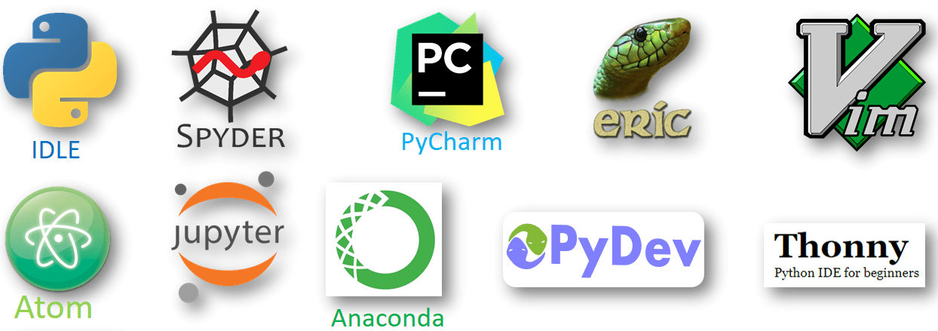
Environment Set-Up
Python IDEs/Editors
Choose what works best for you and if you already have one that works for you, there’s no real need to change that -- the code conventions will remain the same regardless of the IDE. But be familiar with some of the major IDEs available.
Will discuss Jupyter & VS Code, but other options include PyCharm; Spyder; Atom

Slide 19


Python IDEs/Editors - Jupyter
Jupyter
Jupyter Lab/Notebook is installed as part of the Anaconda installation; however, it can be installed separately.
Jupyter Lab -- Spins up with easy access to directories
Jupyter Notebooks -- Easy to spin up from Command Prompt
Extensions to Improve User Experience: Many are simple UI additions, but recent release of a visual debugger is highly useful

Slide 20
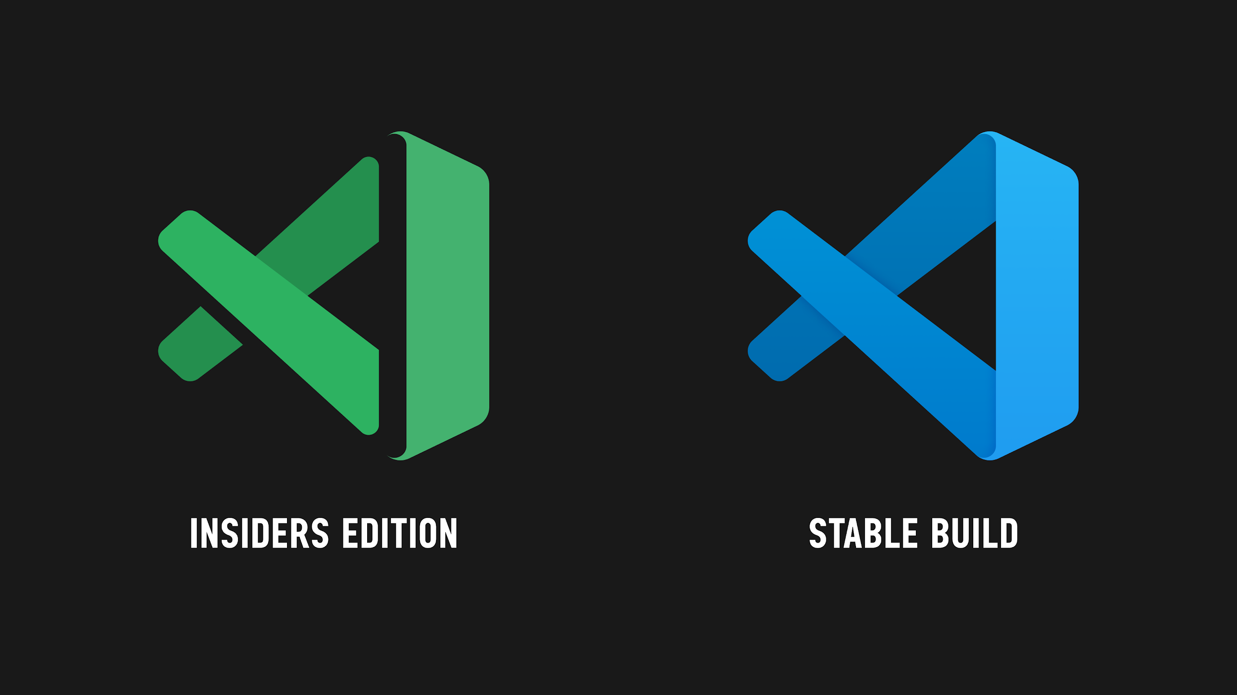
Python IDEs/Editors - Visual Studio Code
VS Code
VS Code - Easy to search and install
Integrations with Python, Go, Java, Ruby, and more
Emmet (expansion tool for markup and CSS) is built-in
Extensions to Improve User Experience: Git Integration; Terminal Access; Jupyter Notebook Extension; MongoDB or CosmosDB Admin Extension; Docker Extension - almost every Docker command can be done from VS Code
Why VS Code? -- Link

Slide 21
Module II - Python Basics
Jupyter Notebook Basics
Python Basics
Variable Creation & Variable Types
Data Types
Lists
Tuples
Dictionaries
If/Else Statements
For Loops
List Comprehensions
Notes:
Original Goal: Provide insights into the complexity involved in Data Science, particularly the types of decisions that must be made and the consequences of those choices.

Slide 22
Python Basics
Jupyter Notebook Basics
Jupyter Lab and/or Jupyter Notebooks can be spun-up from the Command Prompt:
Activate the desired VENV.
Navigate to the desired directory of work.
Simply type in ‘jupyter notebook’.

Slide 23
Spinning Up a New Notebook
Code vs. Markdown Cells
Utilize markdown cells when you can. It is a great way to organize your work, leave detailed notes of current progress, and/or of issues you are troubleshooting.
Library/Package Imports
To stay as organized as possible, import the packages you need in the first cells you make. Even if you need to bring in different packages later, you can always return to this first cell to import them. (When you share your work with others later, they will thank you.)
When In Doubt…
If you notice your code is not running properly or seems to be resulting in errors that don’t make sense, one of the first things to do is to restart the kernel and re-run everything. Notebooks can be glitchy and a soft reboot will help identify if it’s a cell run order issue or a notebook glitch. While it may be a real coding error, restarting the kernel is a simple way to potentially save hours of troubleshooting.

Slide 24
Python Basics
Coding in Python Basics
This section will cover some of the basic concepts required to perform data science work. We’ll cover variables (and types), dtype objects, lists, dictionaries, tuples, if/else statements, for loops, and list comprehension.
There are other functionalities within Python, but this course is designed to give you a quick understanding of the most useful Python functionality for Data Science purposes.

Slide 25
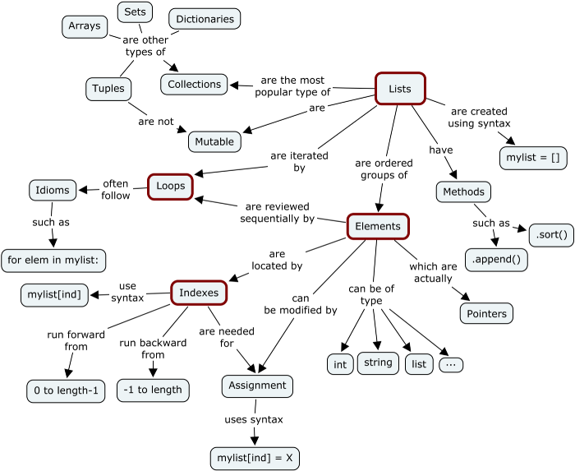
Python Basics

Slide 26
Python - Variables & Variable Types
Variables
In Python, variables are created by assigning a value to a variable. Unlike other programming languages, there is no need to declare the variable prior to assigning a value. Assignment only, no declaration.
Variable Names
Python variables have flexible naming options and can include letters, numbers, or underscores, but must follow some general rules:
Variable names must begin with a letter (A-Z) or an underscore ( _ ). Lowercase or uppercase letters will work.
Variable names cannot be a reserved word in Python.
Additional Python community naming conventions can be found here.
Python Reserved Words List
and | or | in | is
as | with | if | else
elif | for | while | from
not | True | False | None
try | except | continue | pass
return | yield | del | assert
pass | return | yield | break
del | assert | class | def
import | lambda | finally | global / nonlocal

Slide 27
Python - Variables & Variable Types
Variable Types
In Python, there are multiples variable types to classify values: integer, string, float, boolean.
Python infers value types by parsing the value assigned to a variable and deciding its type based on characters.
Type Descriptions
Float -- determined by a decimal within a numeric value (e.g. 3.14)
Integer (Int) -- determined by a numeric whole number (e.g. 40 or 100354)
String -- determined by values consisting of text (e.g. Maria / Maria’s mother was visiting)
Boolean -- determined by keyword values of ‘True’ or False’
None (NoneType) -- Python’s version of an empty or undefined value (e.g. None is Python’s null)
Understanding Types
Python uses types to map values, operators and variables to an internal function.
Python’s version of an undefined variable returns None. To full remove a value, ‘del’ must be used.
Type Equality can be checked using ‘is’.
Python DataType (DType) Objects are different from Variable Types, but function somewhat similarly.

Slide 28
Python - DType Objects & Mutability
DTypes
Python DataType (DType) Objects are used in creating structured arrays which contain multiple types of data (e.g. numeric and text). DTypes are also useful in adapting columns within dataframes.
Mutability
A mutable object is one that can be changed after its creation whereas an immutable object cannot be changed. Whether or not a dtype is mutable is language dependent.
In Python, for example, dictionaries are mutable. If Dict A is set equal to Dict B, any changes made to Dict A would also affect Dict B.
Class | Class Description | Immutable
bool | Boolean value | X
int | Integer | X
float | Floating-point number | X
str | Character string | X
list | Mutable sequence of objects
set | Unordered set of distinct objects
frozenset | Immutable form of set | X
dict | Associative mapping (dictionary)
tuple | Immutable sequence of objects | X

Slide 29
A Quick Note:
Data structures often use an index to access elements/objects of a collection (e.g. lists, dictionaries, tuples).
The first element of a collection will start at ‘0’, not ‘1’.
When accessing elements, they also tend to be upper-bound exclusive.

Slide 30
Python - List Objects
Definition
Lists are a collection object type that are a mutable, ordered sequence of items. A list can be indexed, sliced, and changed. Lists can easily have elements added or removed. Python lists cover the functions of most collection data structures in other languages and, since lists are native to Python, they do not have to be manually created.
Characteristics
Lists can be used to contain any type of object (numeric, string, tuples, dictionaries, other lists).
Each element can be accessed using its position within the list and can be accessed or manipulated through slicing or concatenation.
List variables are declared by setting the variable name to empty brackets [ ] or brackets containing objects.
Indexing & Slicing Notation
Slicing -- method of subsetting data in lists using element indices
list_name[startindex:stopindex] # Selects elements from the specified start index position through [the stop index position - 1]
list_name[startindex:] # Selects elements from the specified start index position through the rest of the list
list_name[:stopindex] # Selects elements from index 0 (very first of the list) through [stop index position - 1]
list_name[:] # Creates a copy of the original list
Notes:
Other functions of lists includes deleting and adding elements

Slide 31
Python - List vs. Arrays
Arrays
Python Arrays are objects with definite type and size; arrays cannot have varying types of data within them. Although arrays are stored as contiguous blocks of memory (as opposed to lists which are pointer to a Python object), the Python Array data structure is not very efficient.
If arrays are needed (as they can drastically improve some modeling functionality), the Numpy Array (a grid of values) is the way to go in Python.
Why Lists in Python?
Lists are simply more flexible than Python Arrays -- list elements can be of any object and each element can have a different type.
Unless you are looking to perform arithmetic functions on your data, lists will permit more fluid manipulations of the data than an array.

Slide 32
Python - Tuple Objects
Definition
Tuples hold together multiple objects; they are similar to lists but with less functionality.
Importantly, tuples are NOT mutable -- once a tuple exists, it cannot be manipulated or changed in any way. New tuples, however, can be established with portions of existing tuples.
Characteristics
Each element can be accessed using its position within the tuple and can be accessed through slicing.
Tuple objects are declared by setting the variable name to parenthesis ( ) containing objects.
A tuple can be used as a dictionary key because it is immutable and, thus, hashable.
Basic Uses
Tuples function similarly to lists -- they can be sliced and indexed the same ways.
Unlike a list, tuples cannot delete or remove individual elements. Only the entire tuple can be deleted.

Slide 33
Python - List vs. Tuple
Understanding Lists & Tuples
If an object is immutable, it can be hashed, and only immutable (hashable objects can be set as keys). For dictionaries, tuples can be used as keys; however, to use a list as a key, it must be converted into a tuple. Lists can never be used as a key.
The nature of tuples and lists affect their usage. Entries within a tuple have different meanings (heterogenous data structures) whereas lists are sequences or entries of similar items (homogenous sequences).
Essentially, tuples have structure and lists have order.
Differentiating Lists & Tuples
A really good (borrowed) example of a tuple vs. list use case is using pairs of page and line number to reference locations in a book.
loc_in_book = (194, 37) # (Page Number, Line Number)
This loc_in_book tuple can be a key in a dictionary that stores notes from multiple locations in the books.
A list could be used to store multiple locations within the book (multiple tuples). It makes sense to add or remove various locations from the book as needed -- a changeable list is perfect.
For an existing location, it doesn’t make sense to adjust that location (it would now be a different place), so an immutable tuple is ideal.

Slide 34
Python - Dictionary Objects
Definition
A dictionary is a collection of key:value pairs. (In other programming languages, this is akin to an associative array.)
A good example would be to say that a dictionary is like an address book. Knowing only a person’s name (a key), we can identify the person’s address or other contact details (values).
For this to work, a key must be unique. You can’t determine an address if two people in the book have the exact same name.
Characteristics
Dictionary objects are declared by setting the variable name to squiggly brackets { } containing keys : ‘values’.
Dictionary Key Restrictions
Almost any type of value can be used as a dictionary key in Python (integer, float, boolean, strings).
A dictionary key must be unique -- a given key can only appear in a dictionary once.
A dictionary key must be an immutable type. (Dictionaries, lists, and sets cannot be keys.)
Dictionary Value Restrictions
There are no restrictions on dictionary values. A dictionary value can be any object supported by Python including lists, dictionaries, and user-defined objects. Duplicate values are also fine.

Slide 35
Python - List vs. Dictionary
How a Dictionary Functions
Python dictionaries function as hash tables under the hood. The keys or index values of a dictionary are passed through a “hash function” that assigns them to unique buckets in memory. A given input value for a dictionary key or index will always access the same bucket when passed through the hash function.
Instead of iterating over every element like in an array or list, this hash function allows for only the index to be passed through to check if anything exists at the bucket associated with the index.
Differentiating Lists & Dictionaries
Dictionaries allow items to be checked directly in constant run time, they are not ordered and require more memory than lists do.
Both dictionaries and lists are mutable; however, with dictionaries, aliasing is a larger concern. Aliasing is when two variables (or names) refer to the same object. When this happens, changes to one variable results in changes to the other.
Copies of a list can be done via the slice method [:] or .copy(). Since dictionary keys cannot be sliced, dictionaries must use .copy().
Notes:
Aliasing also can affect lists.

Slide 36
Python - If/Else Statements
Definition
If/Else/Elif Statements are used in Python for decision-making purposes. This structure allows code to be executed based on whether certain conditions are met.
If/Elif/Else Statements can be nested within larger If/Elif/Else statements; however, the indentation of the code is the only manner of identifying the nested statements and can get confusing. Limit the use of nested If/Elif/Else statements.
Characteristics
The body of an ‘if’ statement is marked by an indentation. The first line not indented marks the end of the if statement.
In a generic statement for existence, Python default interprets any non-zero value as True, while a None or a 0 as False.
In an If/Elif/Else Statement, multiple elif statements can be used; however, only one block of code will be executed. Even if multiple conditions are true, only the first true statement will be executed.

Slide 37
Python - For Loops
Definition
A ‘for loop’ is used for iterating over a sequence in a list, tuple, dictionary, set, or even string object. In a ‘for loop’, a set of statements can be executed for each item contained in a list, tuple, etc. ‘For Loops’ are designed to run for a fixed number of times (unlike a ‘while loop’ which is can run to infinity).
A Python ‘for’ keyword has more in common with the iterator methods found in object-oriented programming languages than ‘for’ uses in those languages.
If you can do it in a for loop, try it in a ‘.apply’ or list comprehension!
Characteristics
Break Statements -- Allow a loop to end before the loop has iterated over every single element.
Continue Statements -- Allow a loop to end the current iteration of the loop and continue with the next iteration.
Pass Statements -- Prevents an error in loop runs; loops must have content, but if there is no content, ‘pass’ will allow the loop to execute without error.
Range Function -- Returns a sequence of numbers starting at 0 (default) and occurring in increments of 1 (default) ending at some specified number. This can be paired with a for loop to iterate over a set of code a specific number of times.
Can Utilize ‘Else’ keywords, If/Else Statements, and Loops can be Nested inside other Loops

Slide 38
Module III - Repos: Saving & Sharing Work
BitBucket / GitHub
Repo Conventions
BitBucket / GitHub Commit Process
Notes:
Original Goal: Provide insights into the complexity involved in Data Science, particularly the types of decisions that must be made and the consequences of those choices.

Slide 39
Repos: Saving & Sharing Work
BitBucket & GitHub
Repositories are excellent hubs for containing entire project code directories.
BitBucket or GitHub offer free and easy-to-use tiers to hold and share your code.

Slide 40
BitBucket & GitHub Walkthroughs
Account Set-Up
Creating a Repo
Admin Access & Sharing
Establishing a New Repo (and its Git Clone)
Git Clone and/or Downloading Some Other Repo
Notes:
Generally speaking, this works best

Slide 41
Repos: Saving & Sharing Work
Repo Conventions
Basic repo conventions facilitate simpler sharing of code with other people on other local machines. Although you can simply push up your code at any point in time and have others pull down and work with the code, there are easy ways to improve sharing, such as in READMEs, directory organization, version control, and branching.
A great example of proper repo etiquette and organization is the repo for AdaptNLP.

Slide 42
Repo Organization
SubDirectories
A complete project should have multiple subdirectories that are easy to navigate. For example, separate folders should exist for the Data, Experimental Code, the full Model, Model Training, and for the How-To/Tutorials.
.gitignore files
.gitignore files are made from .txt files that serve to keep your repo clean from extraneous files like jupyter notebook checkpoints or datasets. (These files take up a lot of memory and bloat your repo.) Any file that should not get pushed up can be added to the .gitignore and will be skipped in any commit.
init.py files
Often empty files, but their existence in a directory with a script allows Python to recognize the script as a callable module for import in a notebook.
README.md Files
README files are more or less text files that detail the purpose of a repo, the contents of a repo, and a quick how-to on the repo.
Link: BitBucket Markdown Guide
Scripts (.py files)
Finalized code should be removed from a notebook and put into a .py file. Complete or finalized functions should be split into distinct processes contained in separate .py files. For example, a script should be made solely for data cleaning or solely for model training.
Tutorial Notebooks
A final repo should always contain a simple notebook that serves as an easy walkthrough of how to use the model or process you’ve made. Ideally, there would only be a handful of cells, each highlighting the simplicity of use and the outputs you receive.
Notes:
Generally speaking, this works best

Slide 43
Trouble with Repos
If you’re mainly working in notebooks for model development, you’ll find that notebooks don’t share easily for collaboration purposes.
Everyone in a group will start with the same notebook, but then wind up sharing their new edited version with different people. All are working at the same time, developing different pieces. At the end, someone has to integrate all the necessary pieces.
Solutions
Version Control -- For data scientists in early model or product development, version control may be unnecessary. However, once a minimum viable product is established, this becomes Version1, and now continued development should be versioned. On larger teams, even early model development should be version controlled.
Modular Scripting -- By modularizing your completed code as you move through the model development process, it allows for easier exchange of code to other colleagues. When a set of cleaning functions or processes are finalized, formatting them into a single .py and then sharing only that form makes it simpler to maintain consistency across the team. (Think small-scale version control super early on in a project.)
Google Colab / KubeFlow -- These are fairly new services that are out and about for use that are intended to improve the ability to develop models as a team. Google Colab, in particular, has promise as it’s built into the Google Drive system (files in google drive can be accessed easily from Google Colab).
Notes:
Generally speaking, this works best

Slide 44
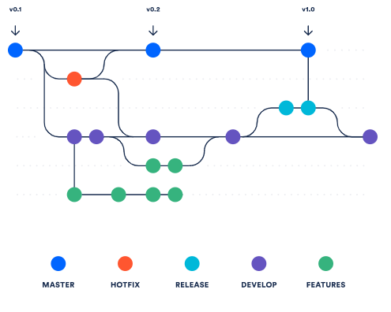
Repository Convention
Version Control & Master/Branches
There are multiple software options that can provide version control systems, including Mercurial (for BitBucket) and Git (GitHub).
Tracks and manages changes to a file system. When operating at the file system level, they track additions, deletions, and modifications made to files and directories. When operating at the individual source code file level, it will track additions, deletions, and modifications of lines of text within a single file.
Version Control & Branching allows for:
1. Easy Development -- Experiment in branches prior to merging to the master 2. Conflict Resolution -- Multiple changes to the same line of code can be audited and addressed easily 3. Rollback & Undo Changes -- When bugs are discovered in the source code, easy rollbacks to a stable version 4. Off-site Source Code Back-Up
Notes:
Generally speaking, this works best

Slide 45
Repos: Saving & Sharing Work
Repo Commit
The commit process is fairly simple and should be done on a regular basis -- when a major update or change to the code has been accomplished or, at the very least, once a day.
Despite being simple, it can be tedious to commit often, but it is a huge timesaver in the long run to keep up with.

Slide 46
Repo Commit
From Within the Command Prompt...
Navigate to the directory you wish to commit files from
Git Clone (if the repo has not been established within this directory yet)
Git Init
Git Add -- All or by Individual Files
Git Commit -m “Commit Message” (A commit message is required -- Might as well make it useful)
Git Push
There will be a login pop-up from time to time during this process -- Simply log in to your BitBucket / GitHub / VS Code account to complete.

